Slide 1

Firma convenzione Politecnico di Milano e Veneranda Fabbrica del Duomo di Milano
CMLS 2022/23
Homework #3 Joystick Controller
Group 12: 0.5 Musicians
Stepanov Maksim
Jian Zhou
Baichen Li
Yueqian Wu
Wenjia Luo
Aula Magna – Rettorato
Mercoledì 27 maggio 2015

Slide 2
Introduction
The aim of this project was to design and implement an easy-to-operate multi-effect controller.
Controlling the Joystick to generate diffenrent effects
Instruments
Recordings
White noise
A graphical interface that reflects the sound effects visually
Possible uses:
Simplifying the equipment for live performances
Integration with audio playback devices

Slide 3
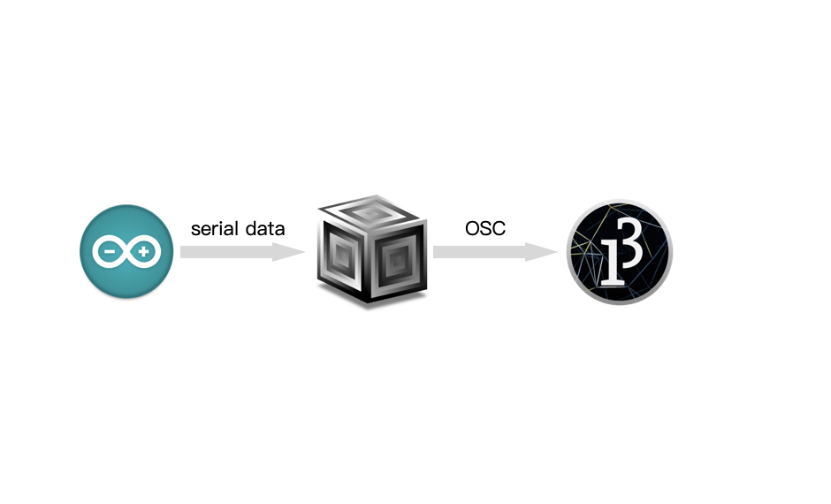
Overall Structure
The values(x axis, y axis and z) read from Arduino are sent to the SuperCollider by serial port.
In Supercollider, different equations for using x and y axis were set in the algorithm of three different effect. And then retrieve the three values in the array sent from serial port and set them as arguments in the three effect.
Finally, the 3 values from SuperCollider and the values of buttons on GUI are transferred mutually by the OSC protocols.

Slide 4
Transmission - Serial communication (Arduino-SuperCollider)
Arduino:
- Serial.begin(9600) initializes serial communication with a baud rate of 9600.
- Use ‘Serial.print’ to read the x, y and z values through the serial communication.
SuperCollider:
- Use ‘p = SerialPort.new("COM3",9600)’ to open a port so that SuperCollider can read the message sent from Arduino via serial port.
- The message received from the serial port is a string. E.g. “516,518,1”.
- Use ‘arr=str.split(Char.comma).asInteger’ to convert the string into an integer array.
- Use ‘arr.at()’ to retrieve the first, second and third values to the x axis, y axis and z.

Slide 5
Transmission - OSC Protocol (SuperCollider – Proccessing)
SuperCollider:
- var recAddr=NetAddr("127.0.0.1",57120); //receiver
- var sendAddr=NetAddr("127.0.0.1",12000); //sender
Processing:
- sender = new NetAddress("127.0.0.1",57120); //send to SC recAddress
- oscP5 = new OscP5(this,12000); //rec
In these two parts, loopback IP "127.0.0.1" is set to send messages.
Port 12000 is for transferring the data from SuperCollider to Processing, and - port 57120 is for transferring backwards.2.2 Arduino and Joystick

Slide 6
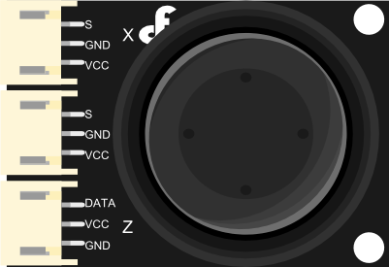
Arduino - Joystick
A standard joystick module that allows the user to alternate 3-dimension values.
In the Joystick,
- S pin of X and Y axes are the output of data for two axes
separately,and connect to analog input A0 and A1.
- DATA pin of Z axis is the output of data, and connect to digital input 3.

Slide 7
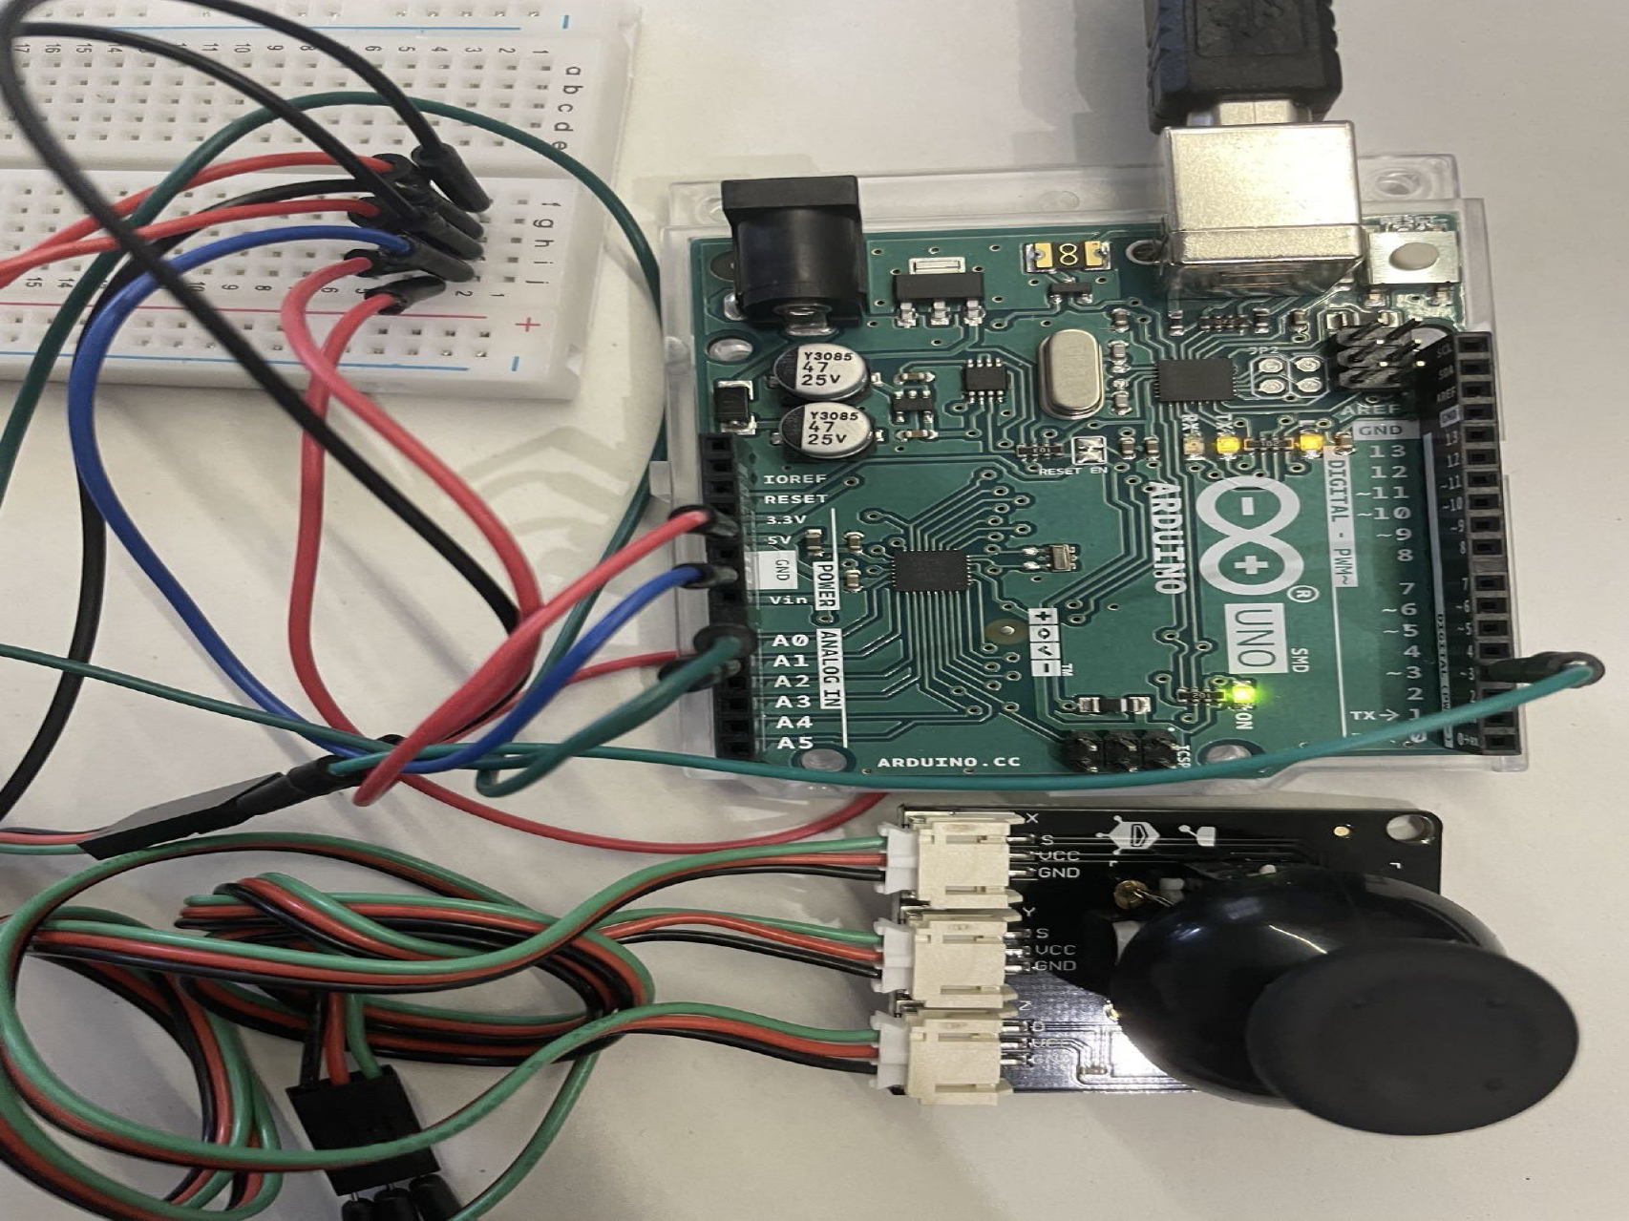
Arduino - Board
- Serial.begin(9600) initializes serial communication with a baud rate of 9600.In the Joystick,
- ‘analogRead’ to read the analog pin connected to the x and y values. The
range of x and y is from 0 - 1023.
- ‘digitalRead’ to read the digital pin connected to the z value, which is ‘0’ or ‘1’.
- ‘Serial.print’ to print the x, y and z values read through the serial
communication.

Slide 8
Supercollider
Working principle
The basic logic of this part is to read the input data through the serial port and control the parameters of the synthesiser according to the value of the data to achieve real-time audio processing and control.
Setting the initial state of synthesisers
Creating and running the loop to handle serial port input
Updating synthesiser parameters: Based on the data sent from the serial port, the synthesiser parameters are updated.
Switching synthesiser operating modes based on button states
Sending OSC messages: Based on the updated parameter values, OSC messages are sent to processing using sendAddr.

Slide 9
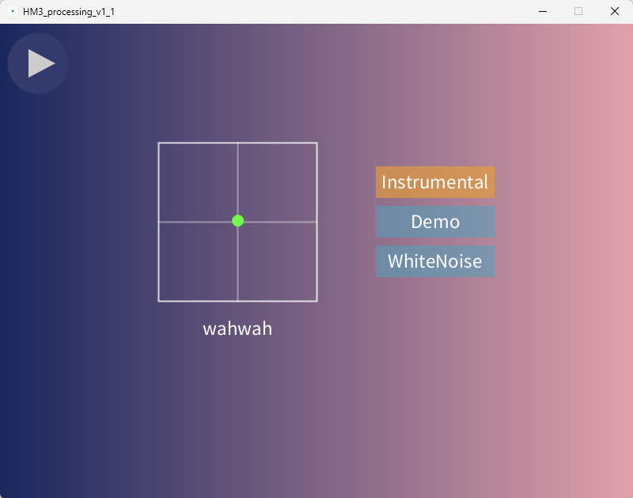
Processing

Slide 10
Further Improvements
Incorporate more effectors, thereby expanding the selection of available effectors for users.
Implement a feature that enables users to custom-define their desired effectors.
Explore sound synthesis capabilities to enhance the potential for a broader range of sound variations.

Slide 11
Firma convenzione Politecnico di Milano e Veneranda Fabbrica del Duomo di Milano
Thank you for your attention！
Analysis of ATLAS-06-Synthesizer
Group 12: 0.5 Musicians
Stepanov Maksim
Jian Zhou
Baichen Li
Yueqian Wu
Wenjia Luo
Aula Magna – Rettorato
Mercoledì 27 maggio 2015

